Slide 1
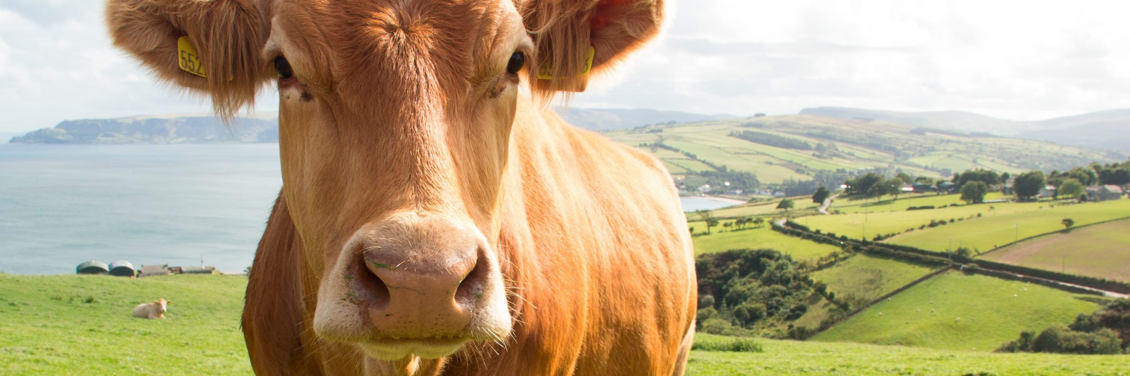

DATA STRUCTURES FOR IMAGE ANALYSIS AND COMPRESSION

Slide 2




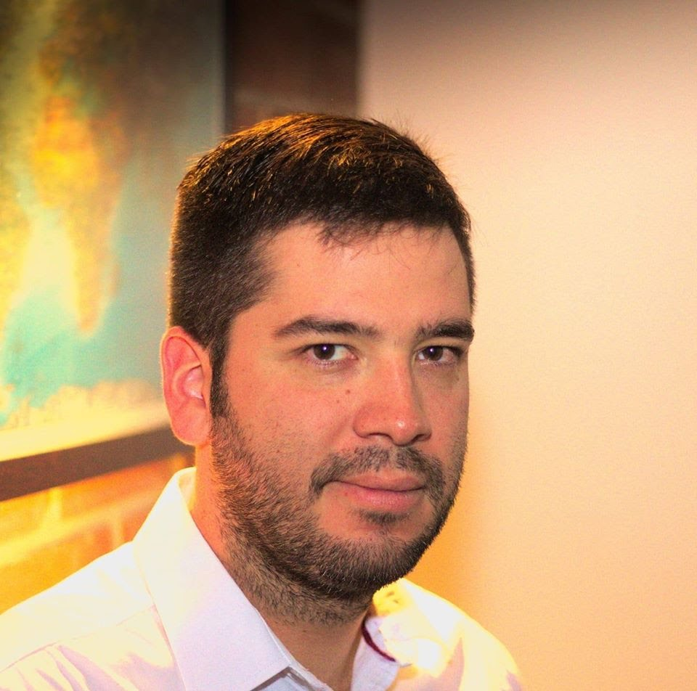

Team Presentation
Juan José
Villada
Simón Marín
Mauricio
Toro
Daniel
Vélez
https://github.com/vlz0/ST0245-002

Slide 3
THANKS!.
Supported by
All the authors would like to thank the Discovery and Creation Vice-rectory of the EAFIT University for their support in this research.

